Slide 1
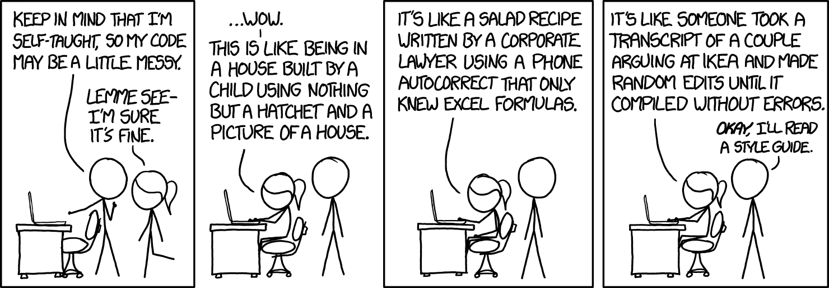
1.6:
Reading and Writing to .txt files
ICS 3U/3C
David Beilby
Zeyad Nasr
Thomas Brittain

Slide 2
.txt files
A simple file type that stores text with little formatting or styling.
We can open and edit these files using various functions in python.
This allows us to accomplish many different tasks such as saving, importing or exporting data.

Slide 3
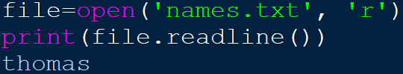
Opening Files
To open a file, we can create a file object using the open() function.
This function returns the file object and takes 2 arguments, filename and mode.

Slide 4
Opening Files
Argument | Result
“r” | Read mode, the code cannot be edited.
“w” | Write mode, this creates a new file if one doesn’t exist but truncates any existing file.
“r+”/“w+” | Read and write or Write and read modes. These allow for both reading and writing, but w+ will still create new, or truncate current files.
“x” | Creates a new file if one doesn’t exist.
“a” | Opens a file for editing without truncating data. Also creates a new file if one doesn’t exist.
Filename takes a string argument with the name of the file.
The mode argument takes a string and defines the function of the file, as shown in the chart.
Note: Trying to read while in w+ mode might not act as expected because changes are only saved after closing the file (or using the file.flush() method)
Files must be closed using file.close() to prevent data corruption.

Slide 5
Using Files
Code | Result
File.readline() | Returns the current line from the file. The default index is 0 (the first line) but increases with each use.
File.readlines() | Returns a list object of every line in the file.
list(File) | Returns a list object of every line in the file
File.write() | Writes the text to the end of the current file.
Print(“”, file=File) | Uses the print function into the specified file. Allows for more complex text editing.
File.close() | Closes the opened file, saving any changes to the computer.

Slide 6
Some Useful Code
When importing data from .txt files, you will often have to edit the strings you import.
.rstrip(“”) is a method of a string that replaces the end of a string if it exists.
.rsplit(“”) splits a string at specified positions into a list.

Slide 7
Challenge!
Create a new file called “Names.txt”. Add five names to the document, which are stored on separate lines. Once you run the program, look in the location where your program is stored and check that the file has been created
Open the Names.txt file. Ask the a user to input a new name. Add this to the end of the file and display the entire file.
Using the same Names.txt file you created, display the list of names in Python. Ask the user to type in one of the names for deletion and then save all the names except the one they entered into a new file called Names2.txt

